Slide 1
Email Tracking BOT Detection

Slide 2
Background on Email Tracking
Sending email campaigns can consume a lot of time and money
But companies that do campaigns successfully can be rewarded with increased business
So knowing the effectiveness of your email campaigns is a critical step
There are 2 main ways to get feedback on your email sends
Add a tracking pixel to the email that lets us know when the email was opened
Change all the links in the email to tracking links
When the contact clicks on a link, the request comes to a tracking service and a redirect to the correct URL is returned
This click request inform us of when every link in the email was clicked

Slide 3
Campaigns and Subscribe Lists
A campaign is an email sent to the addresses in the subscribe list
For the most part, every contact receives the same message
Each campaign can have one or more links in the message

Slide 4
Tracking Links
When the message is generated for each contact, the URL in the links gets replaced with a tracking URL
The original URL is stored in a database with a unique ID
The tracking link knows the link ID stored in the database so the original URL is know
Each tracking link also contains an ID to shows us which contact the click belongs to

Slide 5
Tracking Links
When the contact clicks on a link, they are sent to the tracking server
The tracking server looks up the original URL form the database
A redirect to the original URL is sent back to the contact
This automatically sends the contact to the proper URL

Slide 6
Reporting Clicks
After the contact is redirected to the proper URL, the click request is saved to the reporting system
The tracking link contains the ID of the contact so we know who clicked on what links
The click reporting is a good indicator of how well the campaign performed

Slide 7
Inbox
The contact’s email message is sent to the contact’s ISP (i.e. gmail.com)
For most contacts, the ISP immediately places the new message in the contact’s inbox
The contact sees the message without any delays

Slide 8
Inbox Services
But some ISPs allow companies to add a service that looks at the message before it is placed in the contact’s inbox
These services can be used to check if the email is safe
Open the email on an isolated virtual server
Click on some or all of the links and check for unsafe patterns and Phishing attacks
If ok, release the message to the contact’s inbox
These services will want to evaluate the message as soon as it comes in so the contact doesn’t see any noticeable delay
The immediate click response is a key feature of BOTs
But an actual contact may also have this fast response if the email comes in while they are at the computer

Slide 9
Clicks from an Inbox Service
But the clicks from these inbox services look the same as normal clicks to the tracking server
In fact, these services want to hide their existence as much as possible
If a malicious email can detect the click is coming from a protective service, they could return a safe link to get past the service checks
Then the malicious site could change the redirect to an unsafe destination for the actual contact

Slide 10
Organic Click
A contact can still organically click on a link in the message
The data in the tracking link will be the same for both sources
The only difference between the 2 click requests is the IP address and User Agent

Slide 11
Reporting
Since the inbox service is beneficial, we don’t want to alter the behavior the of the click request
But if we can detect if the click came from an inbox service, we can discard or flag the click request to allow reporting to be more accurate

Slide 12
IP Address and User Agent
The IP address is like a phone number for the internet
It tells use where the request is coming from and allow use to send back a response to that same computer
The User Agent string is a way to determine the type of browser and/or device the request is coming from
The User Agent string for an iPhone is different from the UA from Outlook on Windows 10
This allows web sites to adjust the HTML to fit the device better
The UA also changes with installed features like Flash
100 different computers may have 40 to 60 unique User Agent strings
The combination of these 2 values gives us a good indication of who is making the click request

Slide 13
IP Address Issues
It is not easy to fake an IP address since the response needs to be able to get back to the requesting computer
But there are still many ways to hide you real IP address
Tor networks allows you to submit your request via another host hiding your real IP address
Multiple request could each have their own IP address
But even non-malicious request obfuscate the IP address
The primary problem comes from Network address Translation (NAT)

Slide 14
Network Address Translation (NAT)
Natting is use by virtually all companies
Computers owned by a company do not each have their own pubic IP address
The company builds their own internal network
Each computer gets a private IP address
The NAT has 3 or more public IP addresses for all outgoing requests
So requests from any computer within the company reuse these public IPs
100 computers may only use 3 or 6 public IP address
Natting is used beyond just companies
Cable providers share public IPs for multiple homes
Phone companies share public IPs for requests from smart phones
Cloud service providers like Amazon Web Servers (AWS) can share IP address across multiple account

Slide 15
Network Address Translation (NAT)

Slide 16
IP Ownership
There are a limited number of IP address available (IPv4 = 4.3 billion)
Most IP address are obtained in blocks
A block of IP addresses is called a CIDR range
Classless Inter-Domain Routing
https://en.wikipedia.org/wiki/Classless_Inter-Domain_Routing
CIDR ranges are associated with an AS Number
Autonomous system
https://en.wikipedia.org/wiki/Autonomous_system_(Internet)
AS Numbers are owned by a single company identified by their AS Name

Slide 17
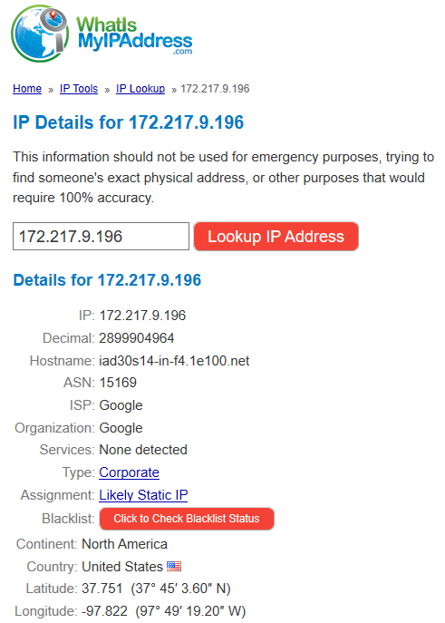
IP Ownership
There are services to lookup ownership of an IP address
These lookups can tell you the owner of the IP (AS Name or ASN)
They can also tell us lat and long of the location of the IP owner
There are also databases that can map IP to CIDR ranges, AS Numbers and Names
This is very helpful for cloud and mobile phone companies
For example, if you have access to a CIDR database, you can map thousands of IPs to one of the 2 mains datacenters for Amazon Web Services

Slide 18
BOT Detection
Historically, blacklisting a few known BOT IP addresses and User Agent strings has been adequate
Frequently a relatively small set of IP addresses were used, perhaps with just one or two unique UAs
But the newer protective services are often hosted on cloud services and can have hundreds of IPs available
They also tend to use User Agents that are very common (iPhone, Chrome on Windows, etc.)
So a different approach is needed

Slide 19
Sessionization
Sessionization is an approach for linking request together
Most email messages contain multiple links
If an inbox service clicks on 10 of these links one after the other, it would be helpful to group these click requests together into a single session
The session should be based on requests coming from the same computer
A session could also be based on the same Inbox (same contact)
By grouping the click requests from a common source, we extend the number of features we can look at
Number of clicks in the session
Number of unique links in the session
Number of contacts in the session

Slide 20
Sessionization
Sessionization requires 2 things
Ordering of the click requests, i.e. click date/time
Grouping Parameters
Same IP and User Agent
Same IP
Same UA
Same CIDR
Same Contact
Same IP, UA and Contact
Total duration between first click and last click
Max time between click times
The ordering by click date is straight forward
But the grouping can have many different approaches

Slide 21
Sessionization
The approach taken for sessionization was:
If time between exceeds 120 second, a new session is created
3 grouping option were are looked. If the first yields good results, we can skip the other 2 grouping options
Group by both IP and User Agent
Group by IP only
Group by InboxID (email contact)
Since historically, the combination of IP and UA has been successful, it was the first grouping strategy tried

Slide 22
Aggregation
Since we are taking a session based approach, most of our metrics used in our modeling will be aggregate data
Some of the aggregation options used include:
Number of InboxIDs (# of contacts)
Total number of click requests
Total number of email domains (i.e. gmail.com, yahoo.com, etc.)
Unique Links requested
100 InboxIDs with 7 clicks each on a message with 40 links, are they all the same 7 links?
Mean duration between SendDate and ClickDate

Slide 23
Approach
Since there are no labels with the click requests, unsupervised learning is the only option
Validation would need to be done manually
Randomly pick n sessions for each group discovered
Do research (IP Lookups, MX Lookups, AWS) to determine if click was from a BOT
Manually add labels to the unsupervised groups
Apply labeled sessions to raw data
Join sessionized data to raw data on grouping values (i.e. IP and UA)
Append labels to the raw data
Derive a score
Some sessions from the same IP/UA may not have been labeled the same
% of raw requests labeled as BOT requests
Use score to blacklist IP/UA and/or CIDR ranges

Slide 24
Possible Approaches to use in Production
Sample click requests on a weekly/monthly basis
Identity BOTs IP/UA or CIDR
Add to existing blacklist
Extract parameters used to differentiate the different unsupervised labels
Add caching layer to tracking server
Load session data into cache
Use model parameters to determine BOT label

